Slide 1
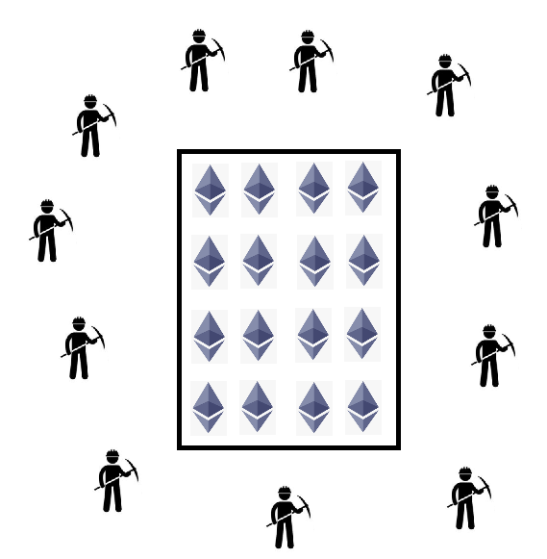
DAO
51% attack
Parent-child Split for Minority

Slide 2
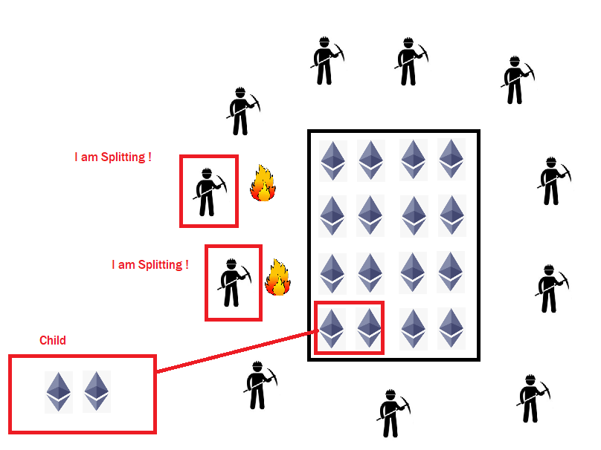
Splitting
Create child
Transfer ether
Burn contract

Slide 3
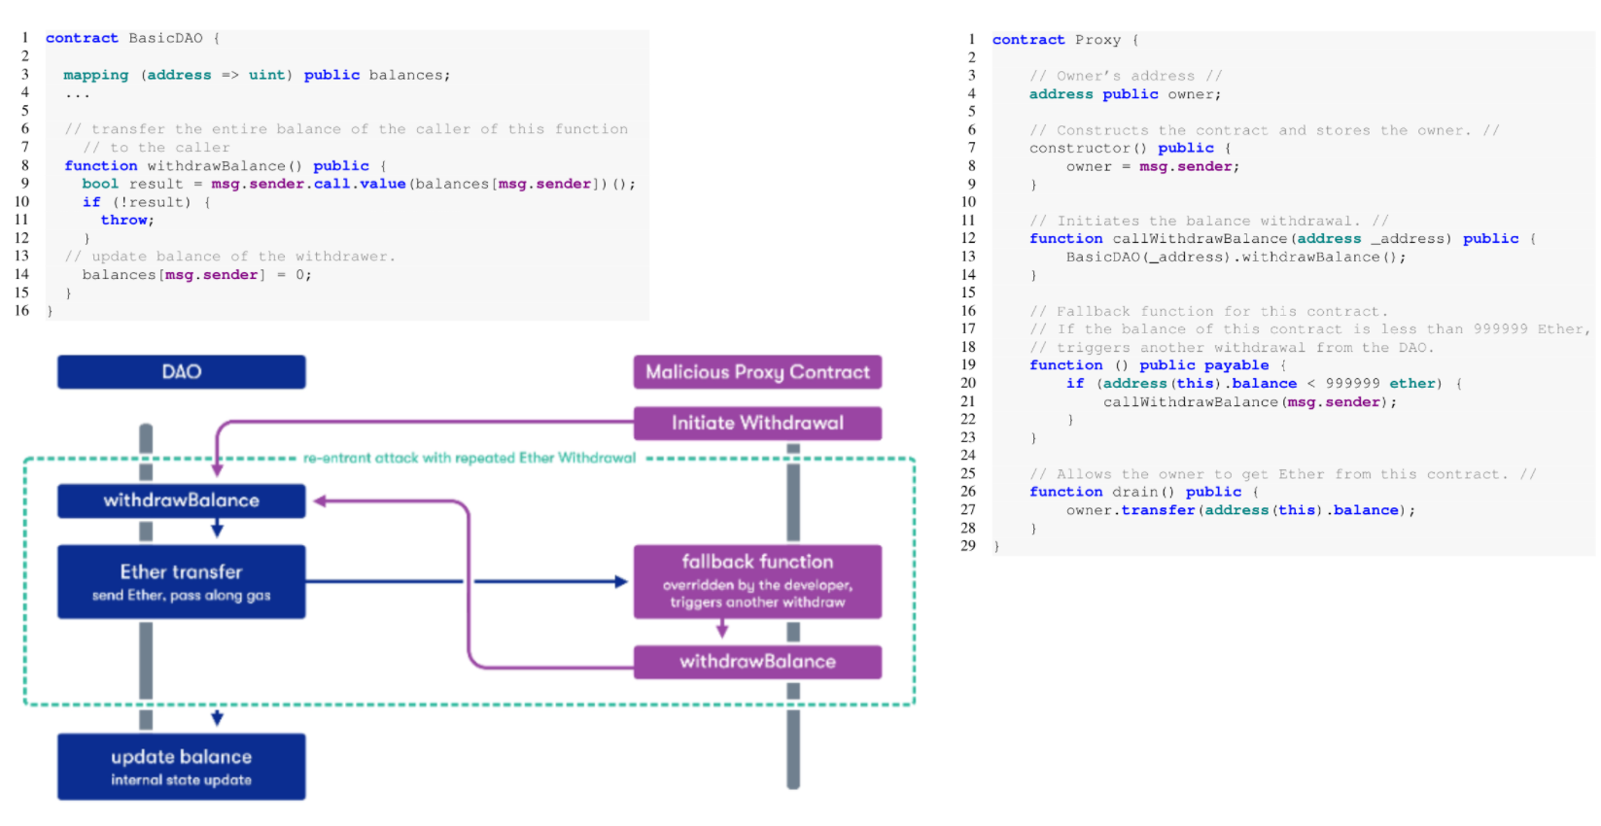
Re-entrancy
The balance of the proxy smart contract was never updated (this happens after the transfer).
Unless the transfer to the proxy contract fails, an exception is never thrown and the state never gets reverted.

Slide 4
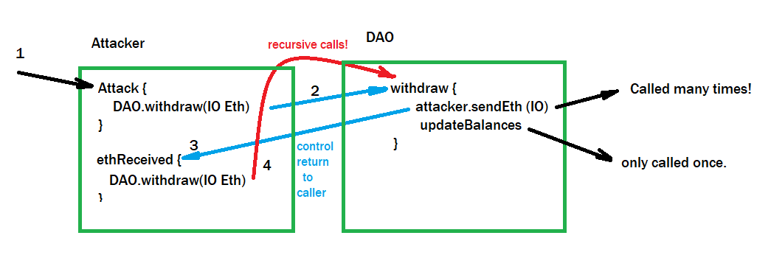
Re-entrancy (Simplified)

Slide 5
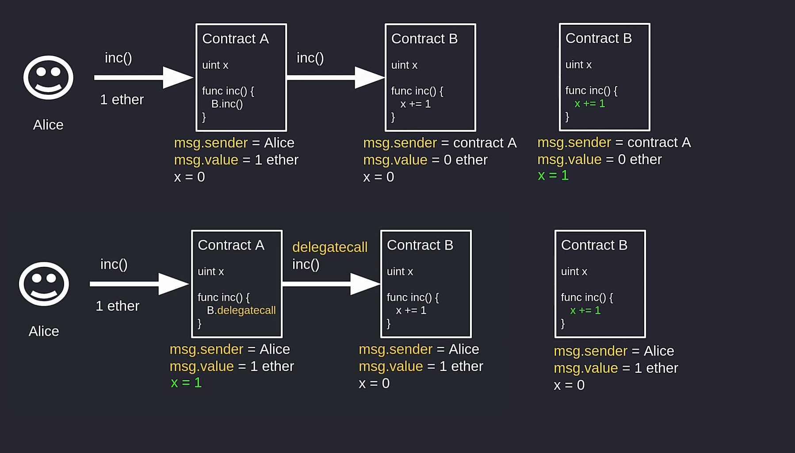
delegateCall

